Slide 1

OCCUPATIONAL HYGIENE MONITORING USING PROJECT BASED LEARNING (PBL) APPROACH
Y.H. Chan
The Hong Kong Institute of Vocational Education – Department of Health and Life Sciences

Slide 2
Introduction
What is Occupational Hygiene Monitoring?
  Involves the use of instrument for the measurement of work-related parameters such as noise, heat stress, gas and vapor concentrations, etc.
  Continuous occupational hygiene monitoring therefore provides a scientific basis to improve the workplace safety. E.g.
    Indoor air quality (IAQ) assessment
    Physical assessment (noise, heat stress)
    Chemical assessment (gas and vapors, solvents)

Slide 3
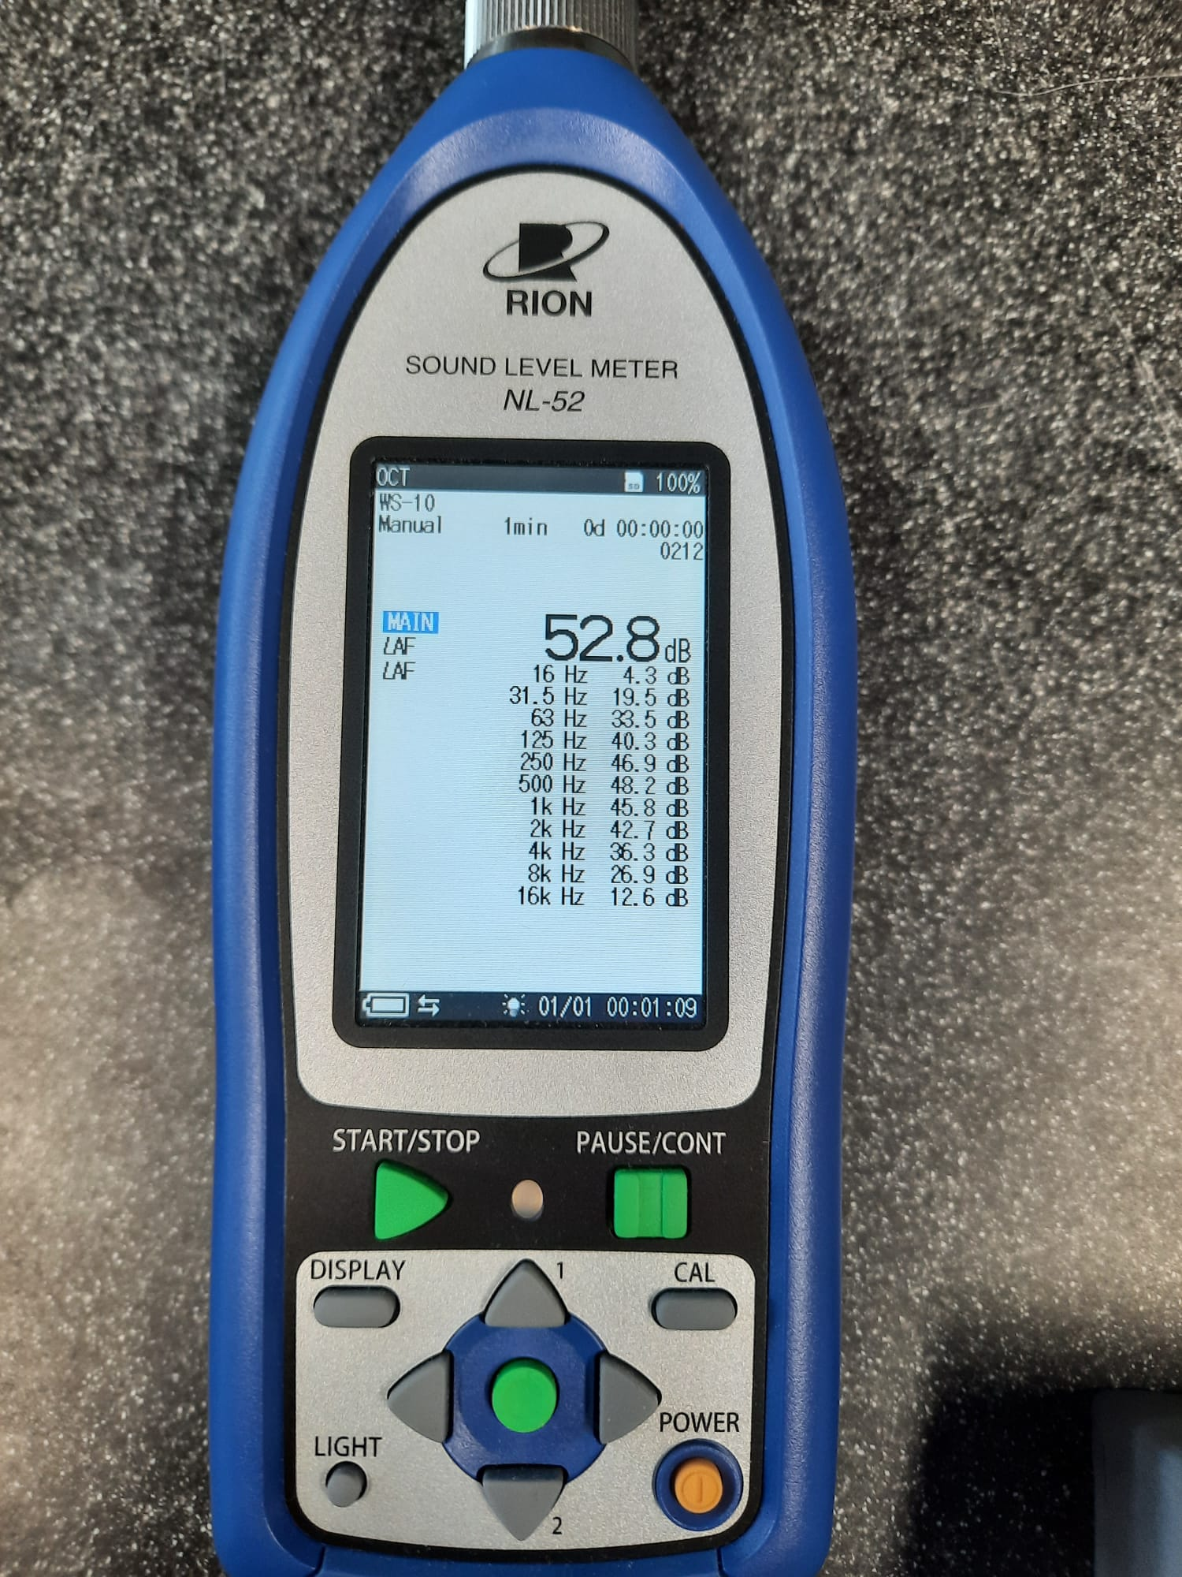
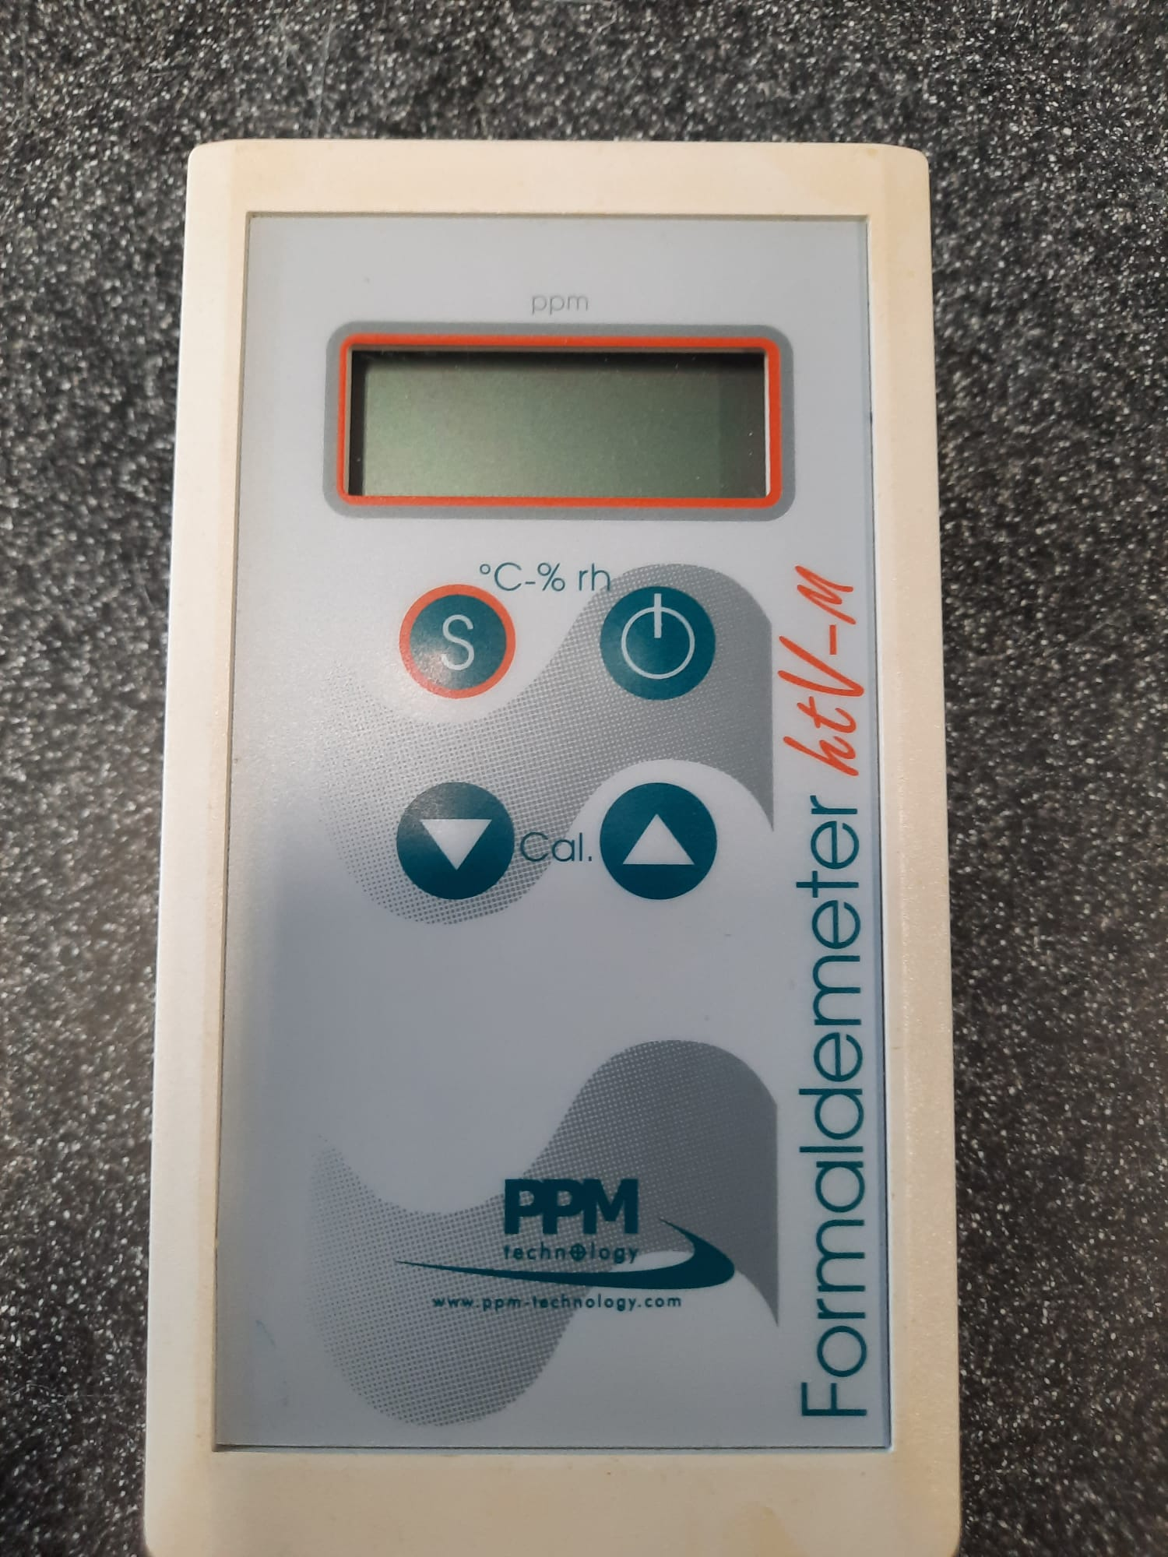
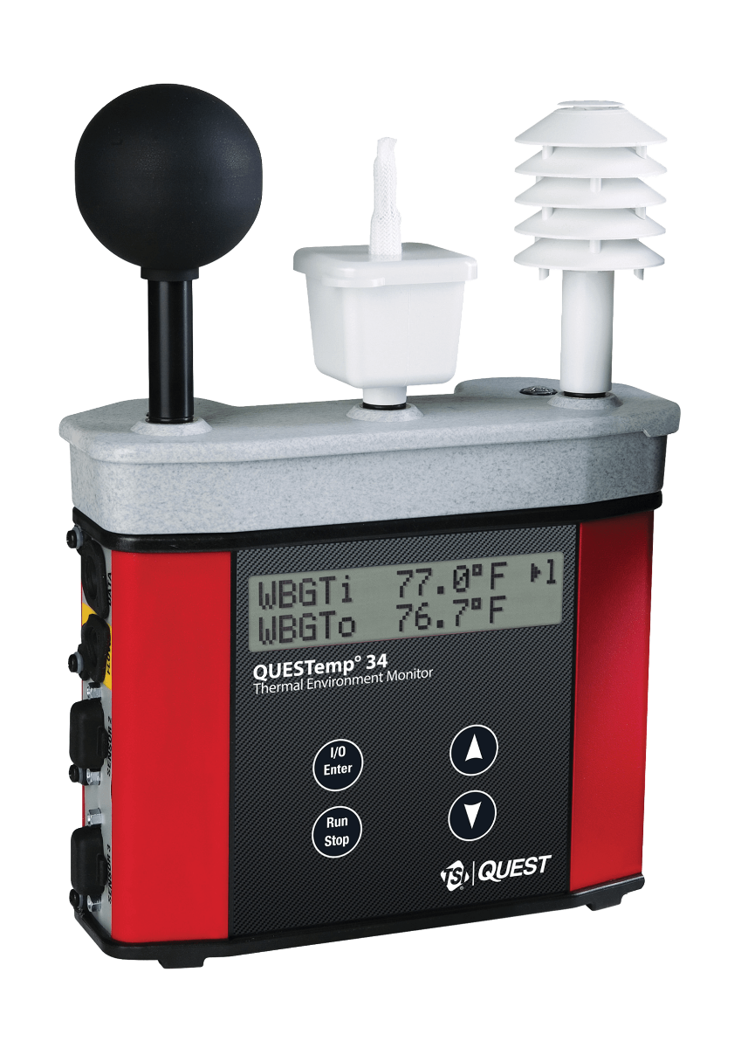
Introduction
Heat Stress Monitor
(Heat stress)
Sound Level Meter
(Noise level)
Formaldehyde Meter
(Gas and vapor)
Source: https://www.airmet.com.au/questemp-qt-34-heat-stress-monitor

Slide 4
Introduction
Why is Occupational Hygiene Monitoring needed?
  In 2022, the total number of occupational injuries in all workplaces in Hong Kong was reported as 32,026 and the number of deaths was as high as 266 (HKLD, 2022).
  From World Health and Organization (WHO), occupational safety and health (OSH) is a multidisciplinary activity with the aim to protect and promote the health of workers by taking precautions against occupational accidents and diseases.
  Occupational hygiene monitoring provides objective data for analyzing occupational accidents and diseases.

Slide 5
Introduction
What Learning Approach is used?
  Since occupational hygiene monitoring requires scientific approach, in-depth student trainings and guidance (e.g. sampling strategies, equipment instrumentation and data analysis) are necessary.
  Project based learning (PBL) is used to let students to work on driving questions to simulate authentic work environment as different workplaces may have different scenarios.
    Students need to actively search information and resources by themselves to solve the problems

Slide 6
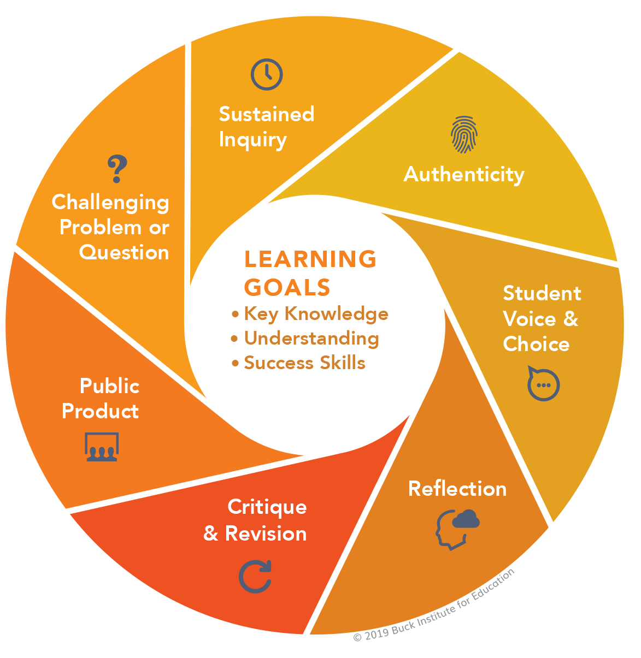
Introduction
GOLD STANDARD PBL
Source: https://www.pblworks.org/what-is-pbl/gold-standard-project-design

Slide 7
Introduction
What Learning Approach is used?
  PBL allows students in asking scientific questions and conducting investigations.
  Due to the complexity in design, PBL usually takes the form of group projects, which allows students to learn through communication and cooperation skills and a necessary soft skill to work successfully in the future.

Slide 8
Introduction
Aims and Objectives
  To promote the occupational safety awareness via students’ trainings.
  To introduce a series of students’ trainings on occupational hygiene monitoring by project-based learning approach.
  To evaluate the effectiveness of integrating project-based learning into teaching and learning.

Slide 9
Materials and methods
The progress…
  Students were divided into groups of 4 to 5 and they worked on the same project theme: ‘Formulation and Implementation of Occupational Hygiene Assessment for a Workplace’.
  Driving question: ‘How do we develop and implement a suitable and effective occupational hygiene assessment for a workplace in order to ensure the safety and health of all employees at work?’

Slide 10
Materials and methods
The progress…
  A two-hour lesson was constructed for students to discuss and brainstorm the topic with guidance given by teacher.
  During the lesson, teacher requested students to propose some authentic workplace environment which requires in-depth hygiene monitoring.
    An interactive and student-led learning atmosphere were established during lesson!

Slide 11
Materials and methods
The progress…
  Students were required to complete a proposal. Several possible workplace scenarios with available monitoring instrument were given:
Possible Workplace Scenarios | Available Instruments
A chemical testing laboratory with several fume hoods in operation. Indoor & outdoor areas where several steam generators in operation. A factory where several heavy manufacturing machineries in operation. An indoor space where painting work using latex paint and thinner in operation. A manufacturing area where production of adhesives of furniture in operation. | Heat Stress Monitor Anemometer Formaldehyde Meter Sound Level Meter TVOC Meter

Slide 12
Materials and methods
The progress…
  Contents of proposal: background information, sampling and measurement plan and brief working principle of selected instrument.
  At the same time, teacher had given a brief lesson on sampling strategies and theory and operation of instruments.
  The above workplace scenarios and instrument were chosen because they could truly reflect the needs of hygiene monitoring for the industry in Hong Kong.

Slide 13
Materials and methods
The progress…
  Teacher arranged five practical sessions to familiarize students with the scenarios and allowed them to have a hand-on experience in operating the instrument.
  After each session, students needed to hand in a report summarizing the findings and data treatment.
  This simulated the workplace assessment report across the industry.

Slide 14
Materials and methods
Assessment Methods…
  Continuous assessment (CA): Group progress assessment evaluated by the teacher on collaboration skills, responsibility skills and communication skills.
  End of semester assessment (EA): Student demonstration on the operation of instrument and data treatment and analysis.
    Students will be assessed based on their technical skills such as instrumental preparation, sampling techniques and data analysis.
  Students were required to complete a feedback and reflective journal. A simple questionnaire was sent to industry partner for their feedbacks.

Slide 15
Results and Discussion
Learning Effectiveness Evaluation:
  Student performance was compared before and after adopting PBL.
    After using PBL: Significant improvement on final practical demonstration.
Without using PBL approach | Using PBL approach
Students reported difficulties in understanding the complicated concepts and instrumentation of the monitoring equipment. Mean score in all assessments: ~70% | Students could know the theory of different occupational hygiene monitoring techniques. Mean score in all assessments: ~80% (~14.3% improvement)

Slide 16
Results and Discussion
An Example:
  Prolonged exposure to high noise level may cause sensorineural loss, damaging the hair cells in cochlea. Students are especially required to measure the workplace noise level.
  In Hong Kong, it is mandatory by the Labour Department to carry out noise assessment at the construction sites.
    Therefore, students should learn to operate the sound level meter and the related theory behind.
  Occupational hygiene monitoring provides an alternative way to safeguard the health of workers and reduce the number of occupational injuries, thus promoting the public awareness of occupational safety.

Slide 17

Results and Discussion
Feedback from Stakeholders – Students
  Majority of students satisfied with the process and outcomes of PBL, and the skills obtained are useful in their future career, however, some students reflected the difficulties in searching information, planning and writing of the proposal.
  All students agreed the adoption of PBL approach in occupational hygiene monitoring could effectively help to understand the concepts and instrumental operation theories.
  Improved performance on practical skill test confirmed the acquisition of the lifelong skills.

Slide 18

Results and Discussion
Feedback from Stakeholders – Teacher
  Students were eager to raise questions regarding the technical skills.
  The learning atmosphere was also improved since students became a key role throughout the whole learning process.
  Besides, students were able to apply what they read and analyse the workplace scenarios in connection with what happened in the real world.
  Therefore, PBL can be used as an effective approach to develop students’ critical thinking development which is an essential soft skill in their future work.

Slide 19

Results and Discussion
Feedback from Stakeholders – Industry Partner
  They agreed that the PBL contents are very related to real world situation and industry linked.
  They also reported it was not difficult to understand what must be done in PBL project.
  Overall, industry partner was satisfied with the performance of the project aims and outcomes.

Slide 20
conclusions
Original complicated theory of occupational hygiene monitoring could have a better understanding towards students using PBL approach.
Students showed significant improvement in their assessment results.
Both students, teachers and industry partner welcomed and showed positive feedbacks.
Cultivating the motivation of students’ learning in this area can therefore promote the awareness of occupational safety in Hong Kong.
It is suggested to adopt PBL approach in facilitating classroom learning atmosphere, especially for some difficult-to-understand concepts.

Slide 21
references
European Agency for Safety and Health at Work (2021). Occupational safety and health in micro and small enterprises. Retrieved from https://osha.europa.eu/en/themes/safety-and-health-micro-and-small-enterprises accessed 4.01.2021.
International, K.M.o.H.a.I.H. (2013). Report of the occupational safety and health risk assessment. Nairobi, Kenya.
Krajcik, J. S., & Czerniak, C. M. (2018). Teaching science in elementary and middle school: A project-based learning approach. Routledge.
Labour Department, Hong Kong. (2022). Summary of Occupational Safety and Health Statistics 2022. Occupational Safety and Health Statistics Bulletin, 22, 1-4.
Montequín, V. R., Balsera, J. V., Fernández, J. M. M., & Nieto, A. G. (2012). Using Myers-Briggs type indicator (MBTI) as a tool for setting up student teams for information technology projects. Journal of Information Technology and Application in Education, 1, 8.
Most, M. S., and D. T. Yates. (2021). Inflammatory mediation of heat stress-induced growth deficits in livestock and its potential role as a target for nutritional interventions: A review. Animals (Basel), 11, 3539.
Pappas, G. P., Herbert, R. J., Henderson, W., Koenig, J., Stover, B., Barnhart, S. (2000). The respiratory effects of volatile organic compounds. International Journal of Occupational and Environmental Health, 6, 1-8.
Sari, N. M., Yaniawati, P., Darhim, & Kartasasmita, B. G. (2019). The Effect of Different Ways in Presenting Teaching Materials on Students' Mathematical Problem Solving Abilities. International Journal of Instruction, 12(4), 495-512.
Tambunan, H. (2019). The Effectiveness of the Problem-Solving Strategy and the Scientific Approach to Students' Mathematical Capabilities in High Order Thinking Skills. International Electronic Journal of Mathematics Education, 14(2), 293-302.
van der Graaf, J., Segers, E., & Verhoeven, L. (2015). Scientific reasoning abilities in kindergarten: Dynamic assessment of the control of variables strategy. Instructional Science, 43(3), 381–400.
Wang, S. (2022). Critical Thinking Development Through Project-Based Learning. Journal of Language Teaching and Research, 13(5), 1007-1013.

