Slide 1
AI-Powered Presentation with Presenter/Speaker Coach
Asha Kumaran & Boey Chee Kin
Notes:
Image ID : 123885946

Slide 2
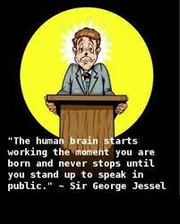
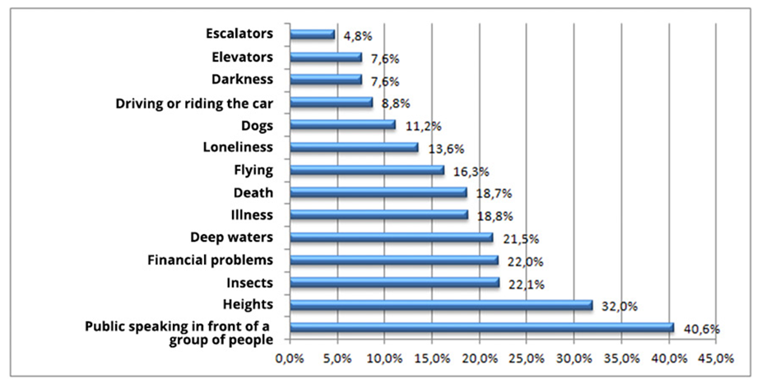

Slide 3
Motivation for the research
Students fear oral presentation because of speaking anxiety (Grieve et al, 2021)
Increased anxiety during the COVID pandemic when Home-Based Learning was used. Students had to practise oral presentation delivery without face-to-face feedback from tutors.
Feedback is defined as “information provided by an agent to a learner relating to their skills or understanding as demonstrated on a task or in the completion of a task, usually after instruction” (Hattie & Timperley, 2007).

Slide 4
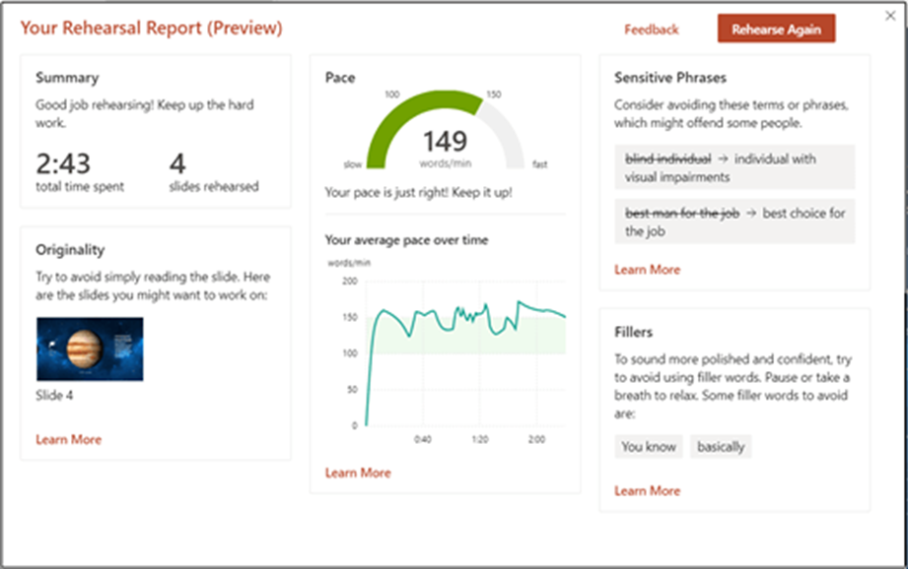
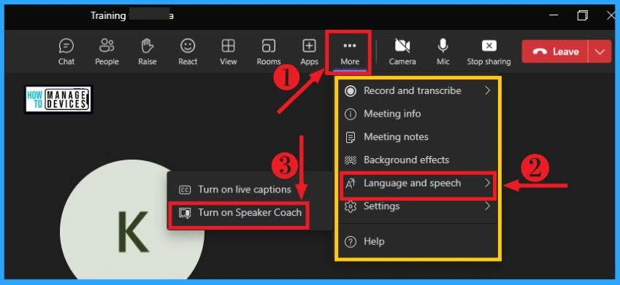
MS Presenter Coach (now called Speaker Coach)
Notes:
Just a brief introduction about the Presenter Coach
The Presenter Coach is an AI-enabled feature in Microsoft PowerPoint which will train you to improve your presentation and public speaking skills and take your presentations to the next level. As the saying goes, practice makes perfect. The Presenter Coach can help you to gain confidence and improve on public speaking by means of training and feedback. By means of training, the Presenter Coach allows you to rehearse with it, provides guidance on pace of delivery, intonation, use of fillers and can even detect if you are simply reading from the slides. At the end of each rehearsal, the Coach provides a report which can serve as valuable formative feedback for improvement. The PowerPoint Presenter Coach watches and listens to you rehearse and shares specific tips and advice, including the new critique categories of pronunciation, word repetition, and body language.
4

Slide 5
Areas of Oral Presentation
Notes:
These are areas we try to address on OP. Coach does not address posture but it does look at eye contact in terms of "originality"--whether there is reading or not.

Slide 6
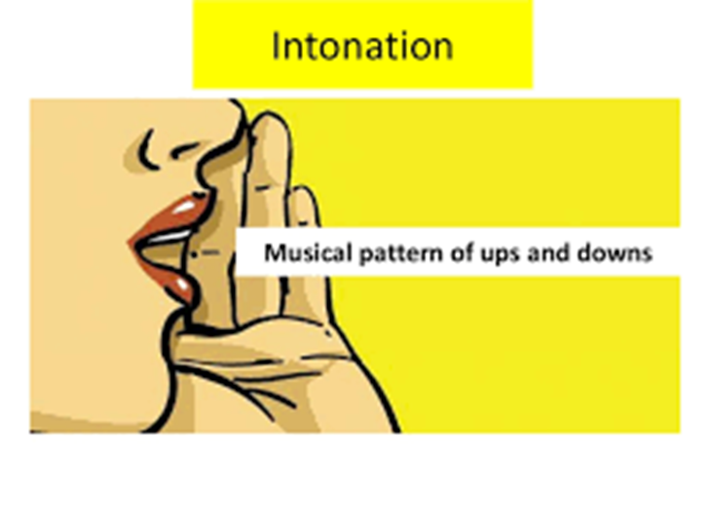
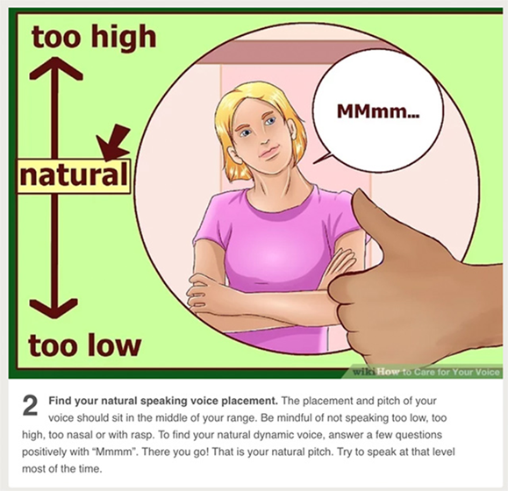
Notes:
I still needed to teach them the concepts so I introduced pace. Pace is the rate of speech and
Microsoft says its research suggests that the rate is 100-165 words at a normal pace. Too fast and the
Meaning and key words do not get retained. Too slow and well… you can ride in that mortuary van…and your audience will lose interest

Slide 7
Research Context: Subjects: Reports & Oral Presentation & Effective Communication
Research Aim:
To study the size of the effect of introducing the MS Presenters Coach now called Speaker Coach in helping learners improve their Oral Presentation skills.
Semester | No of Participants | No. Of Tutors
Oct 2020 | 125 | 3
Apr 2021 | 173 | 5
Sep 2022 | 392 (Perception Survey done) on | 15
Notes:
The research context is that students from 3 part-time or CET diplomas: Diploma in Police & Security Studies, Diploma in Fire Safety and Security Studies and more recently, the Diploma in Security and Workplace Health & Safety. The last dip mentioned came on board only in Apr 21 sem. Wok on this began in a pilot undertaken in Apr 20n followed by 2 semesters of ersearch to collect data. The study has cleared TP Ethics Committee Review for both semesters.

Slide 8
Implementation Timeline Term 2 of Oct 20 & Apr 21 semesters
No exposure to Presenter Coach
Exposure to Presenter Coach
Term 2 (Start)
Trial Assessment 1
(Week 14)
Trial Assessment 2
(Week 16)
Graded Assessment
Use results of Trial Assessment 1 and 2
to compute effect size
(w/o and w exposure to Presenters Coach)
Note:
The same rubric will be used for TA1, TA2 and GA. As the rubric covers a range of areas, we will use only the delivery portion for the research

Slide 9
Research Questions and Effect Size
What is the effect size of practice with Presenter Coach?
What are students’ views of practice with Presenter Coach for oral presentation verbal delivery?
What aspects of verbal delivery do students think Presenter Coach addresses?
Effect size is the magnitude of the difference between groups. The absolute effect size is the difference between the average, or mean, outcomes in two different intervention groups

Slide 10
The Plan Week 12: Lesson on Teams Week 13: Demo of Presenter Coach by Asha to staff Week 14: Trial Assessment 1 on Teams (w/o exposure to Coach) – To record the lesson End of lesson exposure to Coach through a demo of an OP and Presenter Coach Week 15: Self-Practice (submit Presenter Coach report as attendance taking) Week 16: Trial Assessment 2 on Teams (w exposure to Coach) – To record the lesson Week 17: Administer Coach Survey Submit Graded Assessment Week 18: Submit Graded Assessment Administer Subject Survey Documentation Required: 1. Excel mark sheet of Trial Assessment 1 (based on rubric for 60% delivery) 2. Excel mark sheet of Trial Assessment 2 (based on rubric for 60% delivery) 3. Coach Report 4. Coach Survey
Notes:
This is the ersearch plan.

Slide 11
Tips on how to use Presenter Coach
1.Go to office 365. Ensure your internal mic works. You go into slideshow mode in PowerPoint online. Click Rehearse with Coach.
2. Click Get Started to begin your recording.
3. PowerPoint uses your microphone to capture and scan your voice.
4. You begin speaking into the microphone. Focus on the helper tips that appear in the bottom right corner of your screen.
5. Screen shot the overall report with the needed improvements at the end of the presentation.
This Photo by Unknown author is licensed under CC BY.
Notes:
I also gave them a physical demonstration

Slide 12
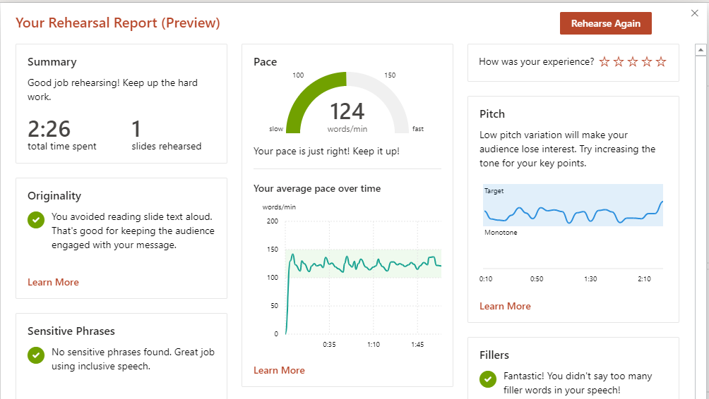
Notes:
So Asha, would you like to share the results of the survey that have been carried out at the end of the semester?

Slide 13
The rubric

Slide 14
Quantitative Findings (Oct ‘20 semester)
Oct ‘20 semester | Trial 1 (No exposure to Coach) | Trial 2 (Exposure to Coach)
Mean | m2 = 9.559783 | m1 = 12.15217
SD | s2 = 0.994055 | s1 = 1.118621
Correlation | r= 0.601970809

Slide 15
Quantitative Findings (Apr ‘21 semester)
Apr ‘21 semester​ | Trial 1​ (No exposure to Coach)​ | Trial 2​ (Exposure to Coach)​
Mean ​ | m2 = 9.559783​ | m1 = 12.15217 ​
SD ​ | s2 = 0.994055​ | s1 = 1.118621​
Correlation​ | r= 0.601970809​ | ​

Slide 16
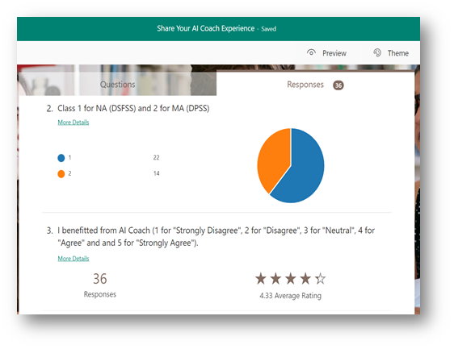
Notes:
Survey Findings Apr '21 semester survey 2 classes did the survey and out of 5 4.33 was the average rating for the benefit they derived.

Slide 17
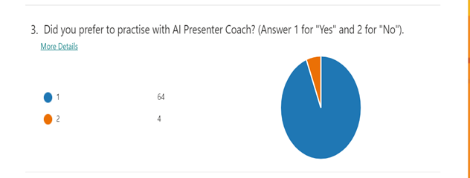
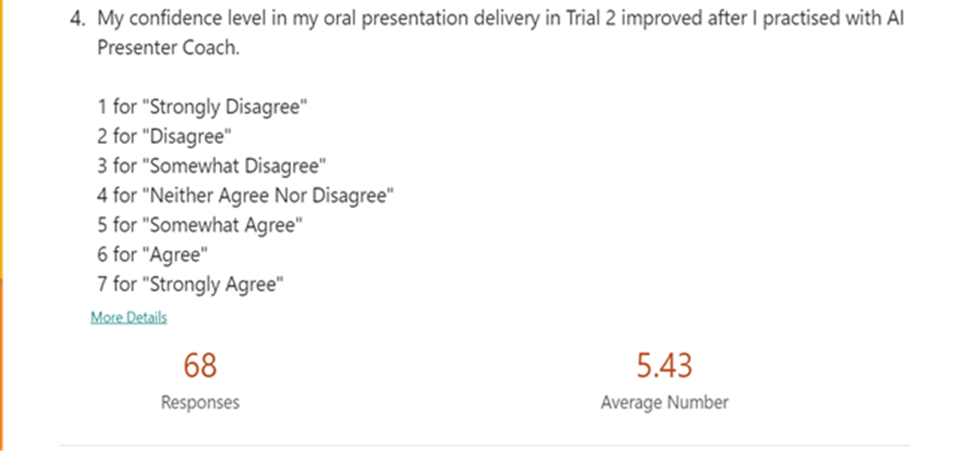
Notes:
Most preferred to practice with AI Presenter Coach

Slide 18
Notes:
Most students picked areas like pace and fillers as well as intonation improvement.

Slide 19
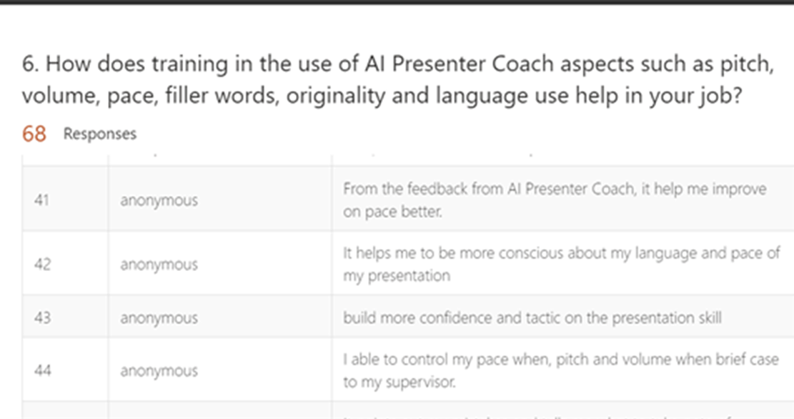
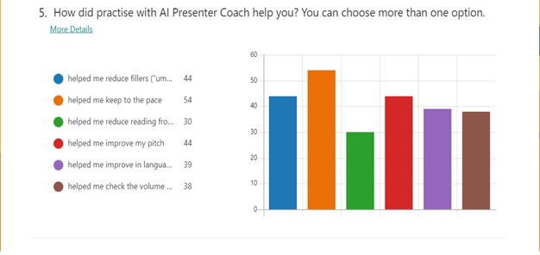
Notes:
The areas of help were pace and also his time--intonation

Slide 20
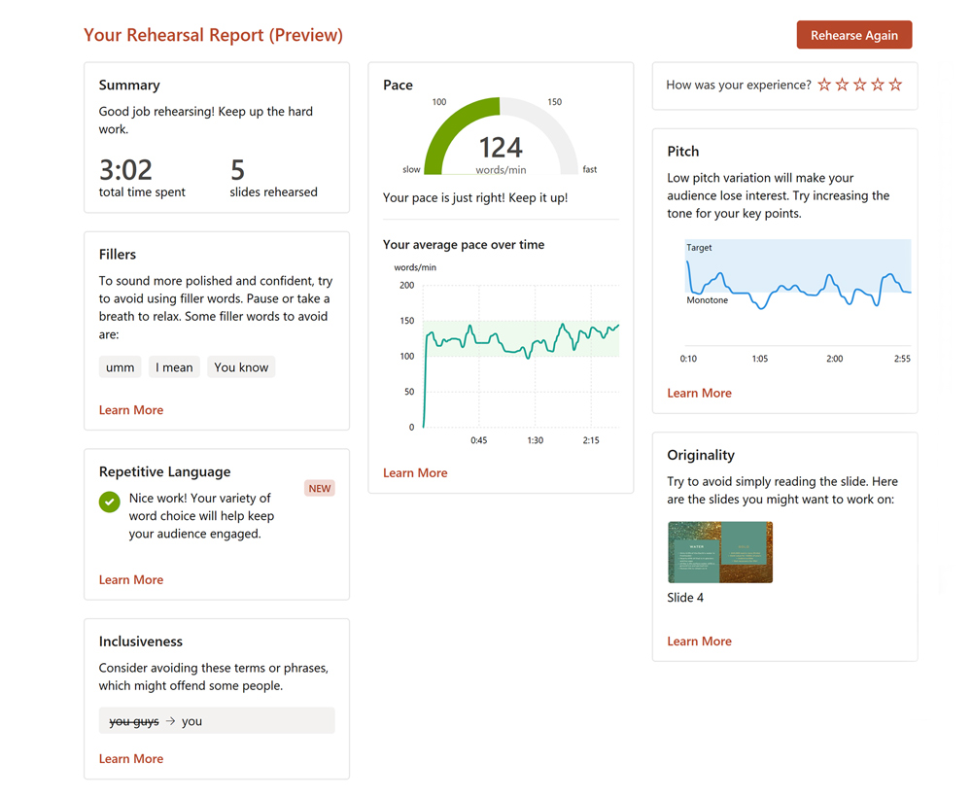
Implications
Study will interest those keen on exploring AI-enabled feedback on oral presentation, with data-driven insights for effective delivery.
Practice with Speaker Coach is generally recognised and perceived by students as positive. Tutor feedback similar to AI feedback.
Based on the feedback, tutors can also plan targetted interventions to help students overcome areas on weakness
AI cannot be overcome by fatigue so students can practise and ask for feedback at any time.

Slide 21
Implications
Tutor not useless. Additional points of help: pronunciation. Can sometimes be confusing as Speaker Coach seems to recognise the American variety of English.
One of the most difficult aspects to address is intonation. Intonation requires tutor intervention because the tendency to slip into a monotone is high.
Future research: examine the use of Speaker Coach in MS Teams, to review and enhance oral presentation in meetings.
Findings in this research can be extended to a larger study so that the results are more generalisable.

Slide 22
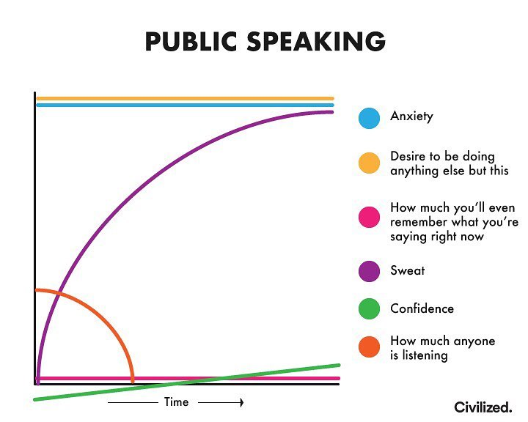

Slide 23
Over to you

